Slide 1
Transfer Learning and fine-tuning
Dr. Hasan Firdaus Bin Mohd Zaki
Acknowledgements: Materials for this slide were adapted from MIT deep learning, learnopenCV, and UWA

Slide 2
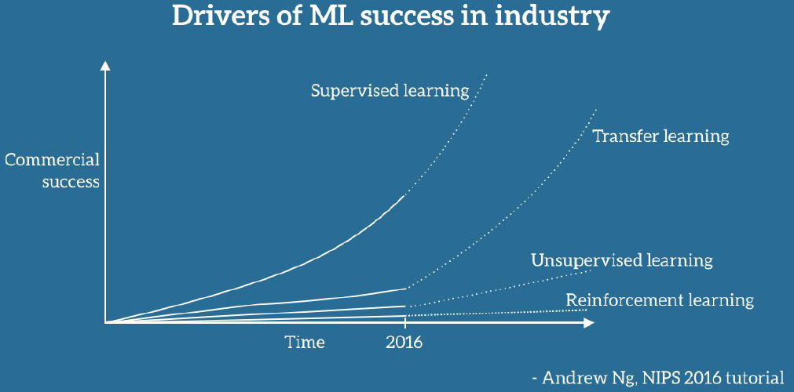
Transfer Learning

Slide 3
Transfer Learning
The ability to apply knowledge learned in previous tasks to novel tasks
Based on human learning, people can often transfer knowledge learned previously to novel situations
Play classic piano → Play jazz piano
Ride Motorbike → Drive a car
Play soccer → play futsal
Math → Machine Learning

Slide 4
Traditional ML
Transfer Learning
Isolated, single task learning
Knowledge is not retained or accumulated. Learning is performed w/o considering past learned knowledge in other tasks
Learning of new tasks built upon the previous learned tasks
Learning process can be faster, more accurate and/ or need less training data
Learning task 1
Dataset 1
Learning task 1
Dataset 1
knowledge
Dataset 2
Learning task 2
Dataset 2
Learning task 2

Slide 5
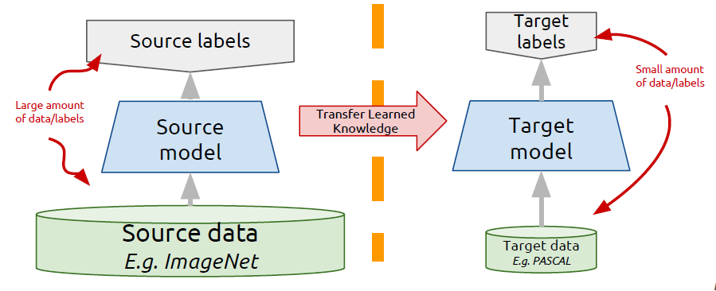
Transfer learning: idea
Instead of training a deep network from scratch for your task,
Take a network trained on a different domain for a different source task
Adapt it for your domain and your target task
Variations:
Same domain,
different task
Different domain,
same task

Slide 6
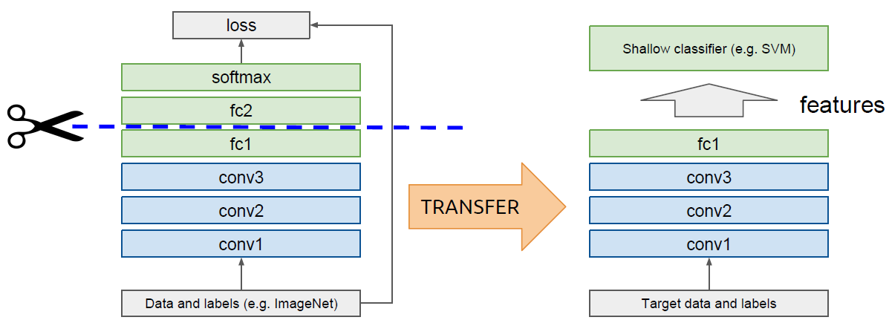
Domain adaptation using “off-the-shelf” CNN
Idea: use outputs of one or more layers of a network trained on a different task as generic feature extractors. Train a new shallow model on these features.

Slide 7
Domain adaptation using “off-the-shelf” CNN
Works surprisingly well in practice!
Surpasses or on par with state-of-the-art in several tasks in 2014
Image classification:
PASCAL VOC 2007
Oxford flowers
CUB Bird dataset
MIT indoors
Image retrieval:
Parik 6k
Holidays
UKBench
Razavian et al, CNN Features off-the-shelf: an Astounding Baseline for Recognition, CVPRW 2014 http://arxiv.org/abs/1403.6382

Slide 8
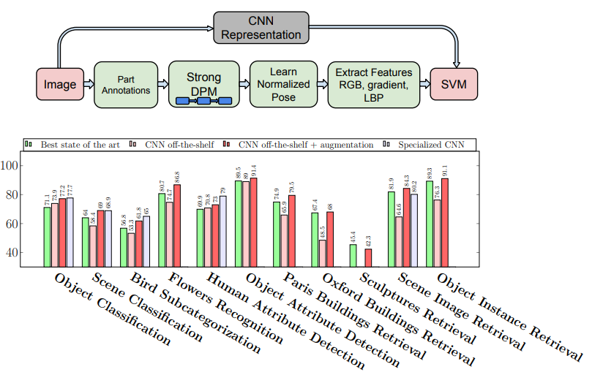
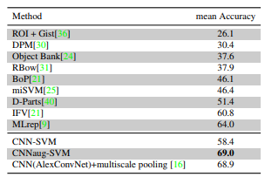
Domain adaptation using “off-the-shelf” CNN
Razavian et al, CNN Features off-the-shelf: an Astounding Baseline for Recognition, CVPRW 2014 http://arxiv.org/abs/1403.6382

Slide 9
Can we do better than off-the-shelf features?

Slide 10
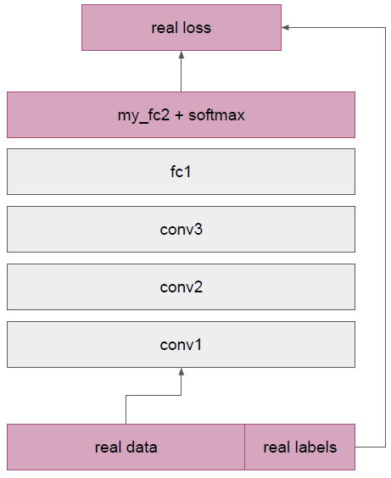
Fine-tuning: supervised domain adaptation
Train deep net on “nearby” task for which it is easy to get labels using standard gradient descent + backprop
ImageNet classification
Cut off top layer(s) of network and replace with supervised objective for target domain
Fine-tune network using backprop with labels for target domain until validation loss is minimized

Slide 11
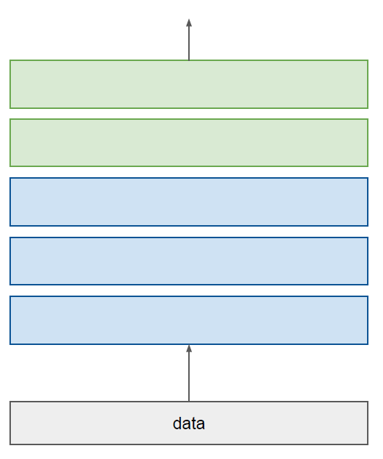
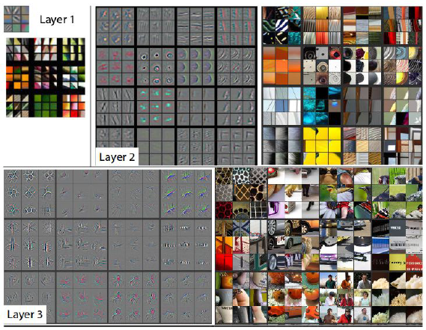
How transferable are features?
Lower layers: more general features. Transfer very well to other tasks.
Higher layers: more task specific (more semantically meaningful)
label
Matthew Zeiler, Rob Fergus, “Visualizing and Understanding Convolutional Networks”, CVPR 2013

